Slide 1
AI-Based Mental Health Chatbot
Batch - 22
221FA04151 – G. Maneesha
221FA04161 – K. Kumari Supraja
221FA04206 – K. Lavanya
Guide : Dr. Rambabu Kusuma

Slide 2
PROBLEM STATEMENT
Many people, especially students, face mental health challenges such as stress, anxiety, and depression in their daily lives. Due to academic pressure from exams, placements, and continuous studies, students often feel overwhelmed and emotionally drained. However, there is a lack of immediate and accessible mental health support systems that can assist them at the right time. Therefore, there is a strong need for a 24/7 AI-based solution that can provide instant emotional support, guidance, and basic mental health assistance whenever required.

Slide 3
OBJECTIVE
Build an AI chatbot for mental health support
Detect emotions from user input
Provide helpful responses and suggestions
Support students and general users

Slide 4
Technologies
Frontend: HTML, CSS, JavaScript
Used to create user interface and chatbot layout
Handles user input and displays responses
Backend: Python (Flask)
Manages server-side logic and API requests
Connects frontend with AI model
AI/NLP: TextBlob + Keyword Detection
Detects user emotions using sentiment analysis
Uses keywords to identify intent accurately

Slide 5
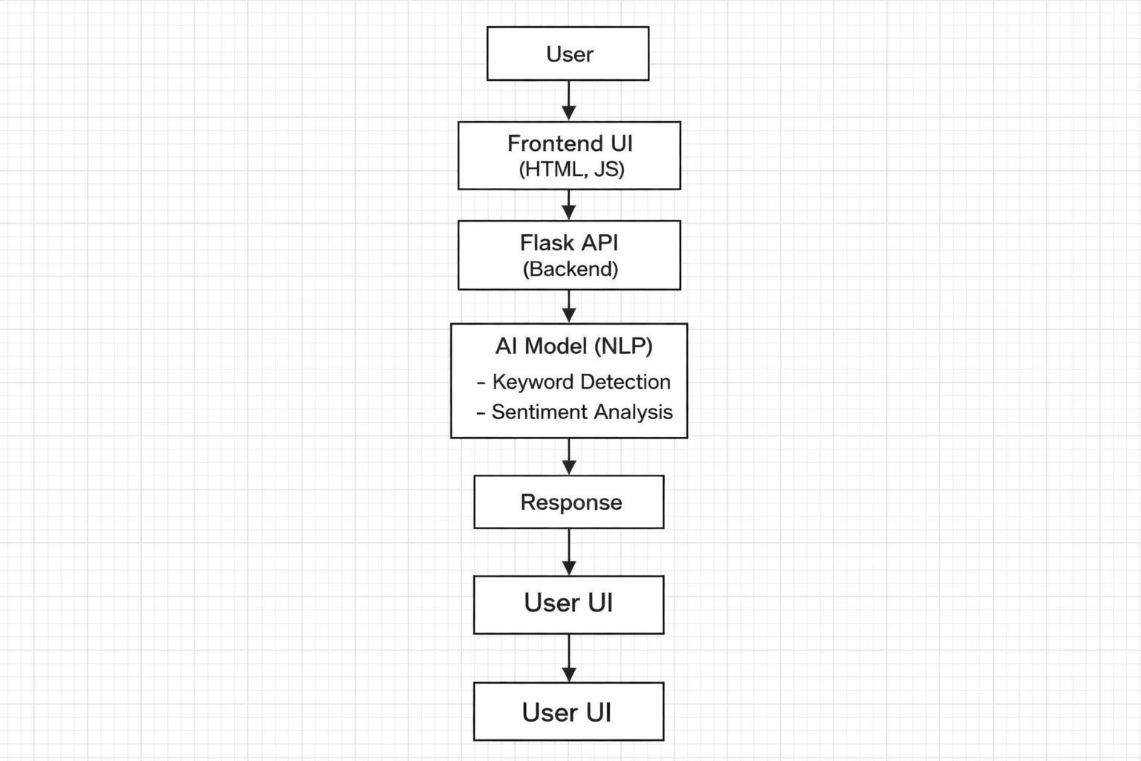
System Architecture

Slide 6
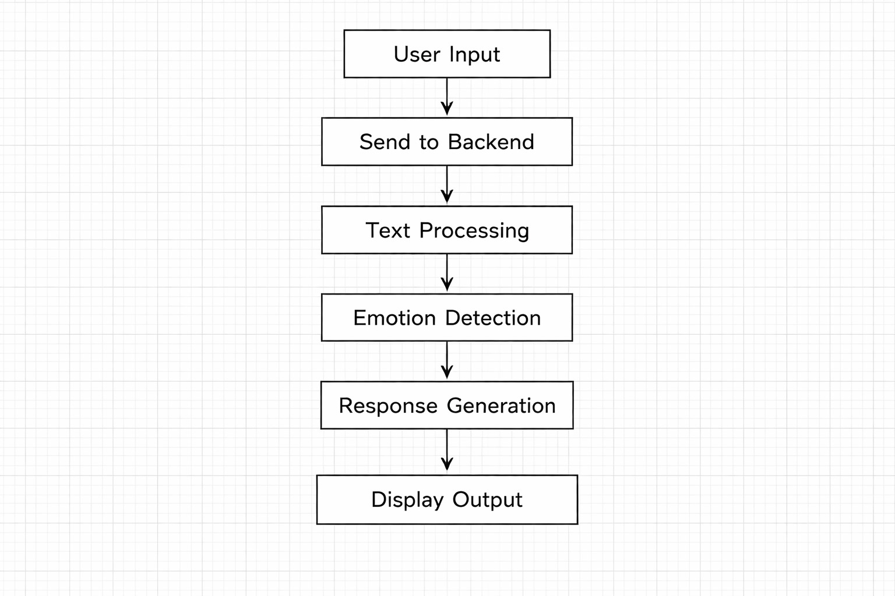
Workflow

Slide 7
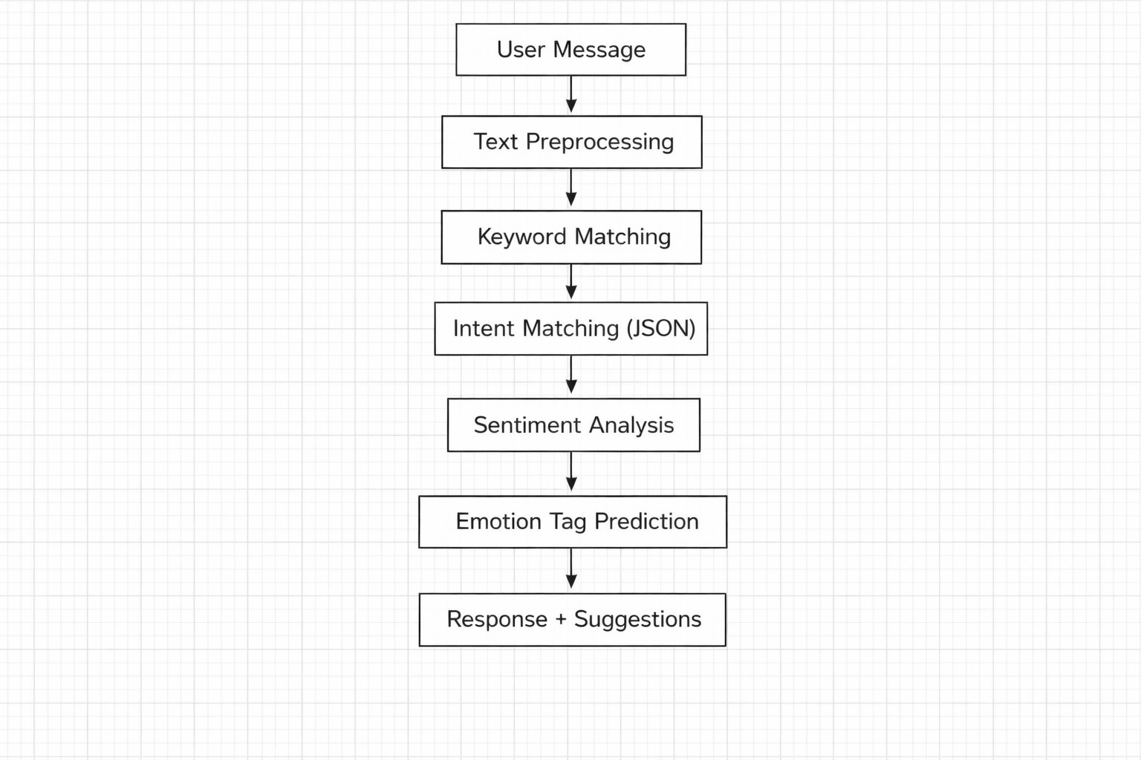
Methodology

Slide 8
AI Approach
Keyword-based detection
Identifies important words like sad, anxious, headache
Helps quickly classify user emotions
Intent matching using JSON
Matches user input with predefined patterns
Returns appropriate responses and suggestions
Sentiment analysis (TextBlob)
Analyzes text polarity (positive, negative, neutral)
Helps detect overall mood of the user
Hybrid approach for better accuracy
Combines keyword detection + intent matching + sentiment analysis
Improves understanding of different sentence structures
Fallback mechanism
Provides general response if no exact match is found
Ensures chatbot always replies
Domain-specific detection (health & student stress)
Handles cases like headache, exam stress, quitting studies
Provides relevant suggestions based on context

Slide 9
Features
Chatbot Interaction: Enables users to communicate easily and share their feelings
Emotion Detection: Identifies user emotions like happy, sad, anxiety, etc.
Suggestions: Provides helpful tips such as relaxation and coping strategies
Critical Alerts (Helpline): Guides users to seek immediate help in serious situations
Health Advice: Gives basic suggestions for common health issues
Student Stress Support: Assists students dealing with academic pressure and stress

Slide 10
Constraints
Cannot Replace Doctors: Provides support only, not professional medical advice
Limited Understanding: May not fully understand complex or unclear inputs
Ethical Concerns: Must ensure responsible handling of sensitive mental health issues
Data Privacy: Requires secure handling of user information

Slide 11
Advantages
24/7 Availability: Provides support anytime, anywhere
Instant Response: Gives quick replies without delay
Easy Accessibility: Simple to use for all users
Supports Mental Well-being: Helps users manage stress and emotions

Slide 12
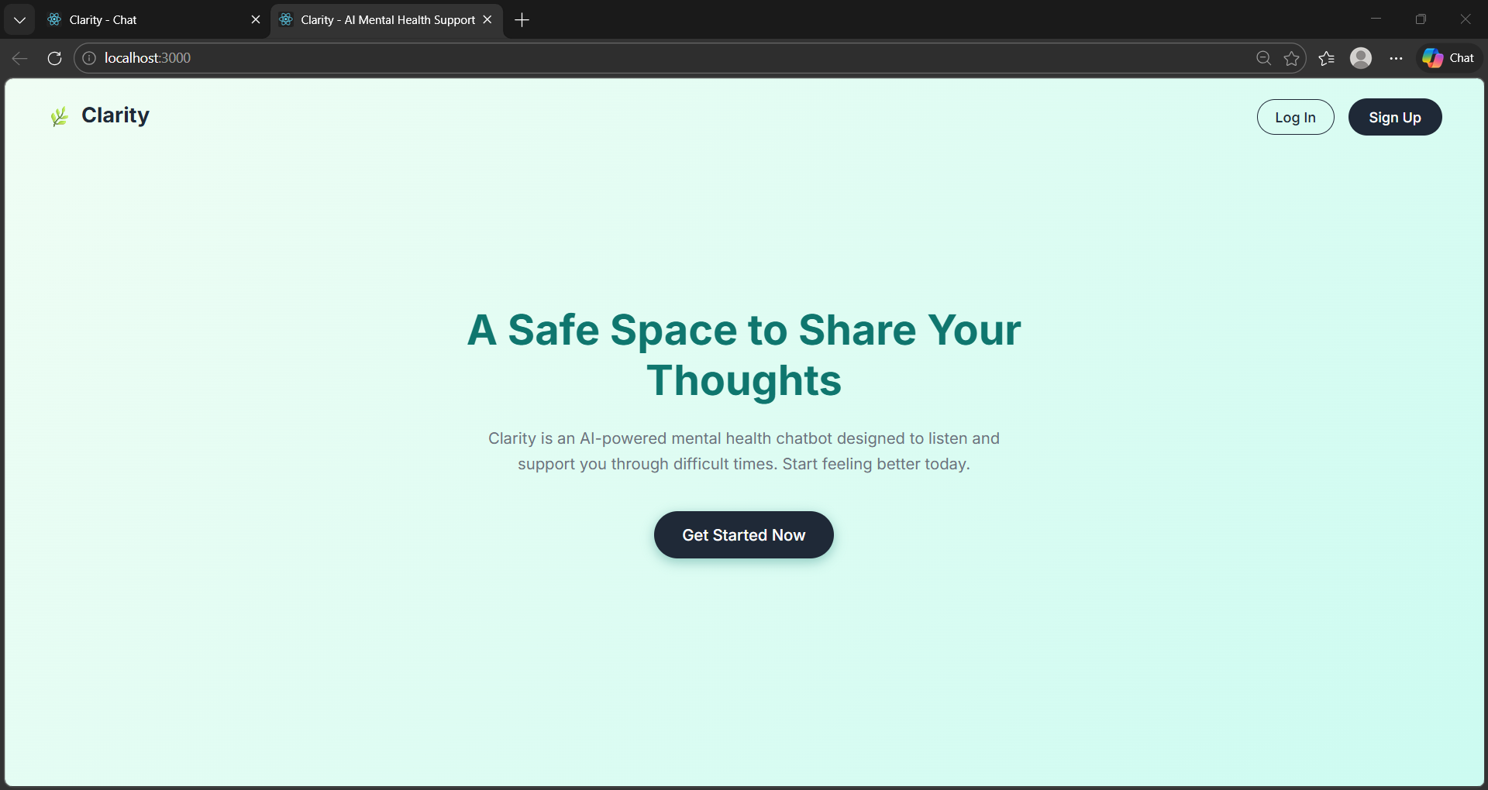
Output

Slide 13
Future Scope
Mobile Application: Develop a mobile app for better accessibility and user experience
Advanced AI Models (BERT): Improve accuracy using powerful deep learning models
Integration with Therapists: Connect users with professional mental health experts
Voice-Based Interaction: Enable voice input for a more natural conversation

Slide 14
Conclusion
The AI-based mental health chatbot helps users express their emotions in a safe and supportive environment. It provides basic mental health support by understanding user feelings and offering helpful suggestions. The system is especially useful for students as well as general users who may be dealing with stress, anxiety, or loneliness. Overall, it is a scalable AI solution that can be further enhanced to provide more advanced and personalized support in the future.

Slide 15
Thank You

